Slide 1

Explainable Artificial Intelligence for Diabetes Prediction
INDEX
SP-LIME (SUBMODULAR PICK – LIME) OVERVIEW
SP-LIME ALGORITHM PREREQUISITES
SP-LIME (ALGORITHM)
SP-LIME (LIMITATIONS)

Slide 2
Explainable Artificial Intelligence for Diabetes Prediction
SP-LIME (SUBMODULAR PICK – LIME) OVERVIEW
The LIME authors authors also SP-LIME, which tries to pick a small yet representative set of explanations to efficiently describe the overall model (example-based explanation).
1. Run the explanation model on all/selected available instances
2. Compute the global importance of features
3. Iteratively add the instances with the highest maximum coverage gain to representative non-redundant explanation set

Slide 3
Explainable Artificial Intelligence for Diabetes Prediction
SP-LIME ALGORITHM PREREQUISITES

Slide 4
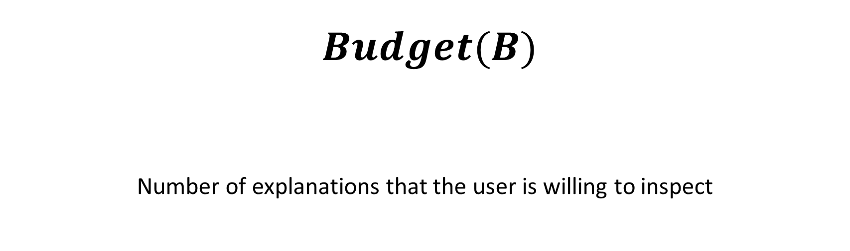
Explainable Artificial Intelligence for Diabetes Prediction
$Budget(B)$
Number of explanations that the user is willing to inspect

Slide 5
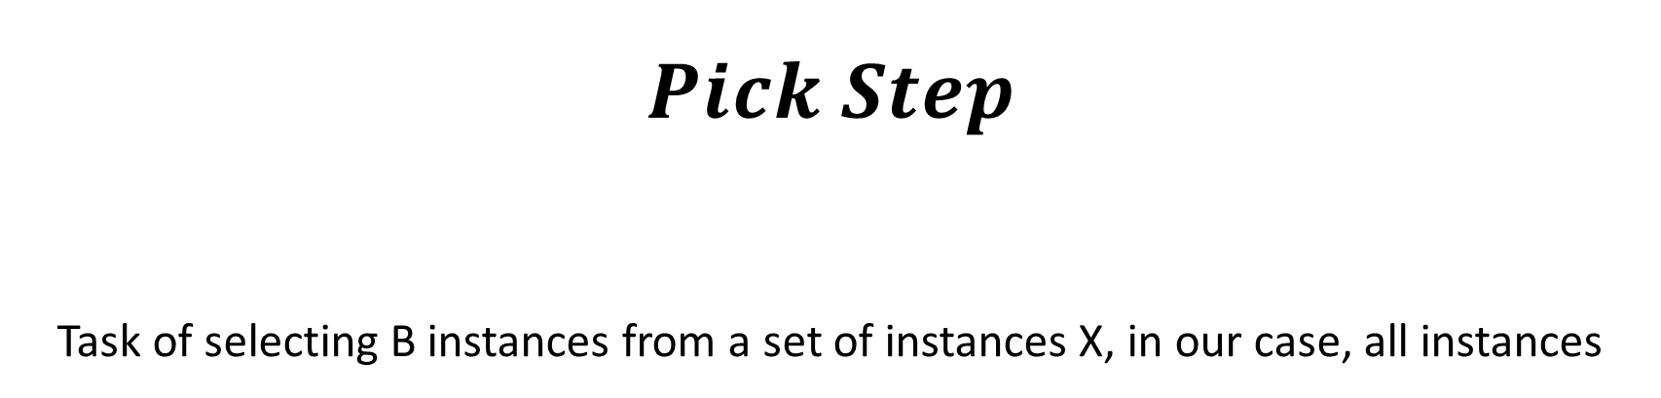
Explainable Artificial Intelligence for Diabetes Prediction
$$Pick Step$$
Task of selecting B instances from a set of instances X, in our case, all instances

Slide 6
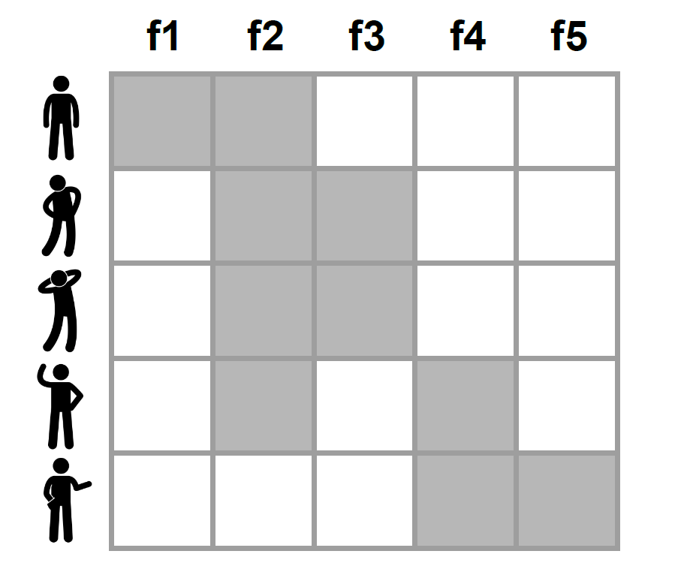
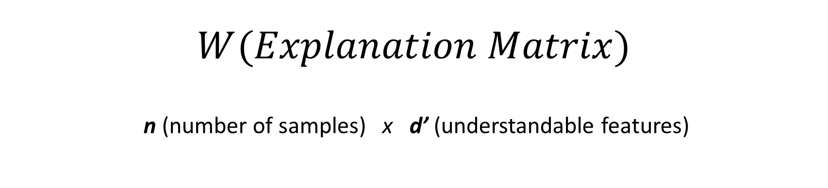
Explainable Artificial Intelligence for Diabetes Prediction
$$W(Explanation Matrix)$$
n (number of samples) x d’ (understandable features)

Slide 7
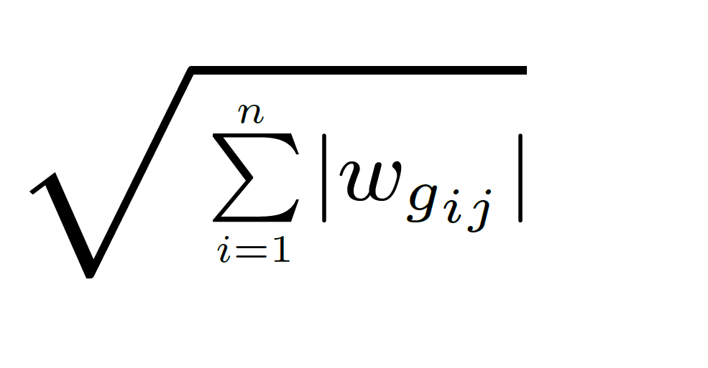
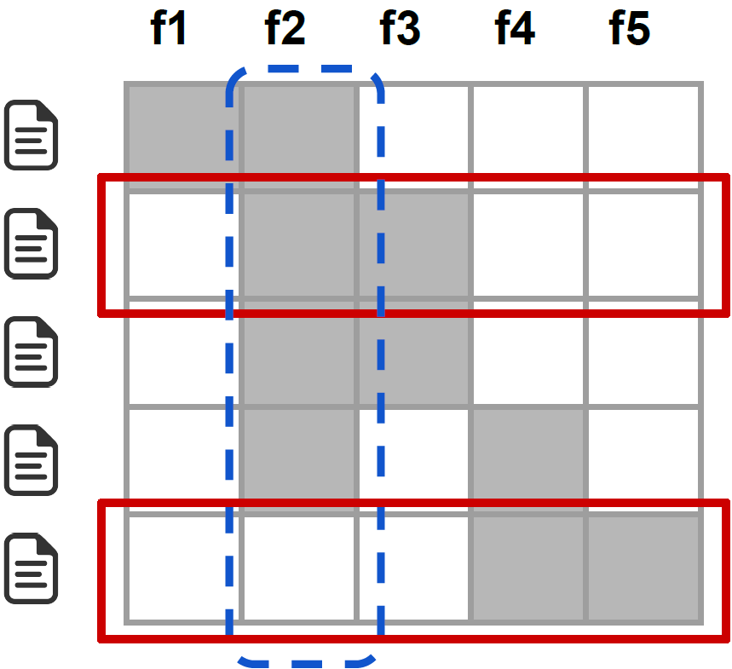

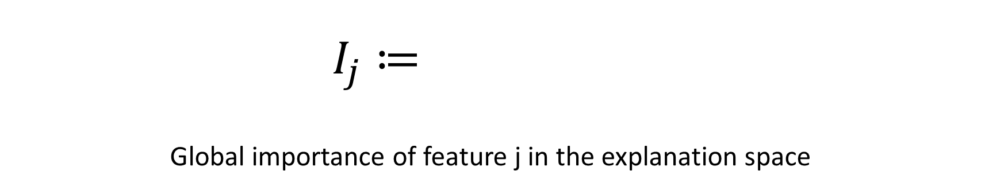
Explainable Artificial Intelligence for Diabetes Prediction
$I_{j}≔$
Global importance of feature j in the explanation space

Slide 8
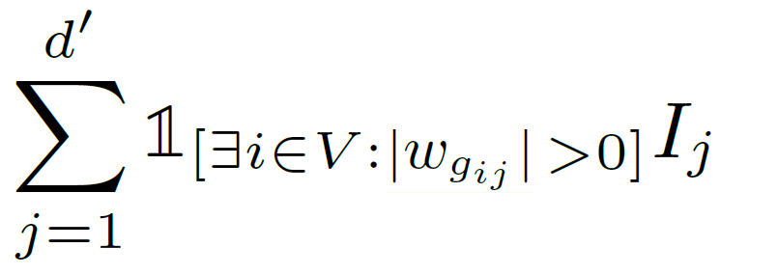
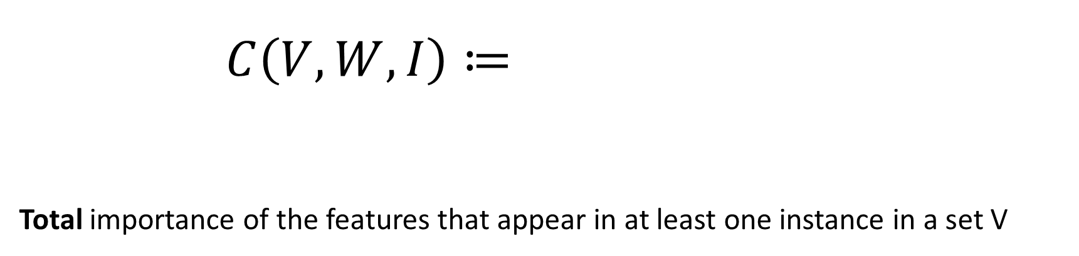
Explainable Artificial Intelligence for Diabetes Prediction
$C\left(V,W,I\right)≔$
Total importance of the features that appear in at least one instance in a set V

Slide 9
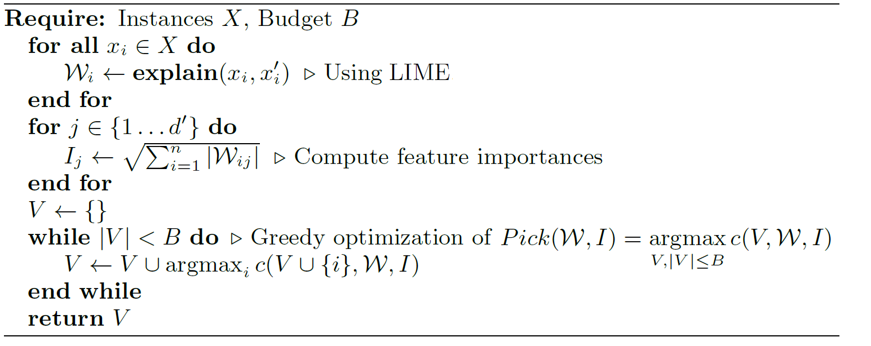
Explainable Artificial Intelligence for Diabetes Prediction
SP-LIME (ALGORITHM)

Slide 10
Explainable Artificial Intelligence for Diabetes Prediction
SP-LIME (ALGORITHM)

Slide 11
Explainable Artificial Intelligence for Diabetes Prediction
SP-LIME (ALGORITHM)

Slide 12
Explainable Artificial Intelligence for Diabetes Prediction
SP-LIME (ALGORITHM)

Slide 13
Explainable Artificial Intelligence for Diabetes Prediction
SP-LIME (LIMITATIONS)
- SP-LIME algorithm is based on a greedy approach which does not guarantee an optimal solution.
A greedy algorithm is any algorithm that follows the problem-solving heuristic of making the locally optimal choice at each stage.
- Limitations inherited from lime

